Slide 1
INTD 150 Library and Internet Research Ms. Larucci

Slide 2
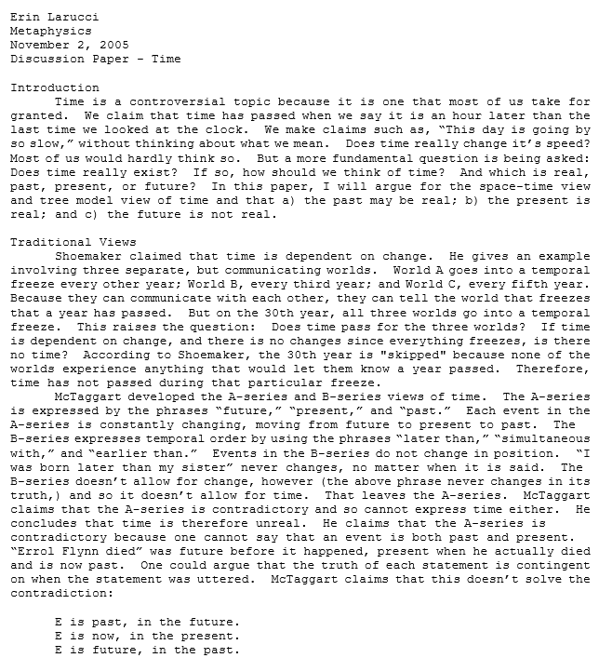
When you think of research, you probably think of research papers

Slide 3
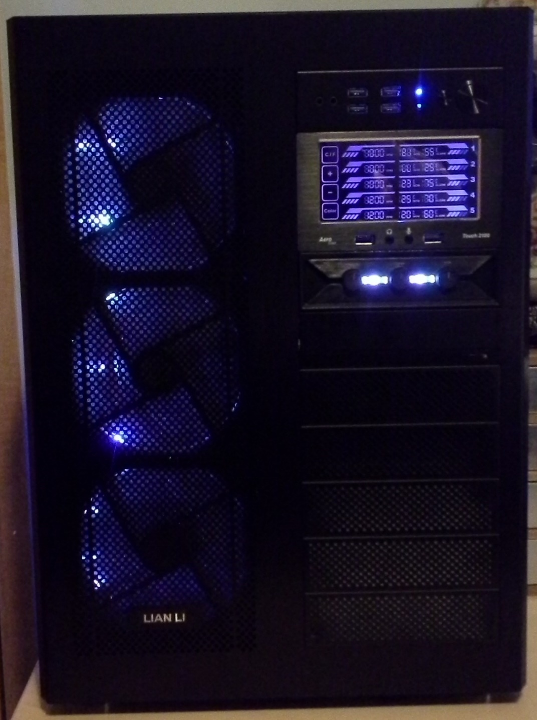
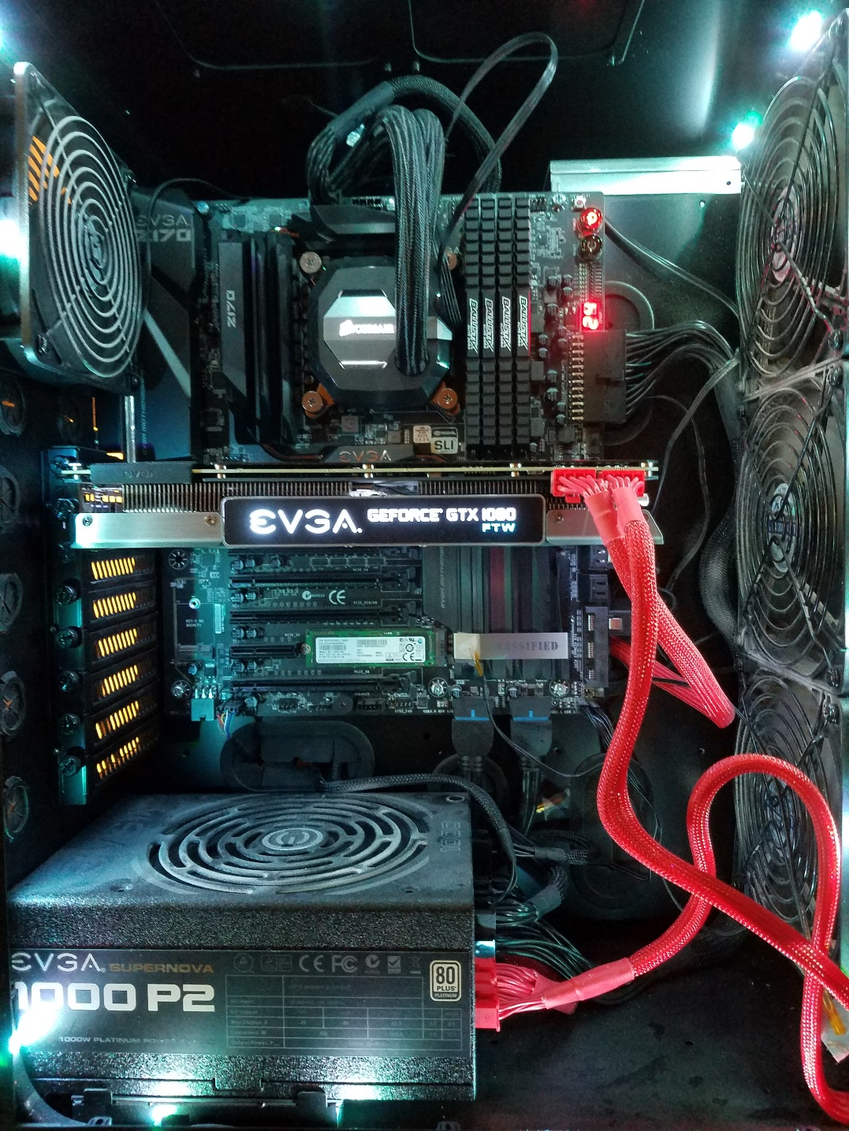
But research can also be for entertainment…

Slide 4
…or research could be for a health problem (or relocating or politics or…etc)

Slide 5
Purpose of Course
Can you find…
…what you need?
…when you need it?
…from appropriate sources?

Slide 6
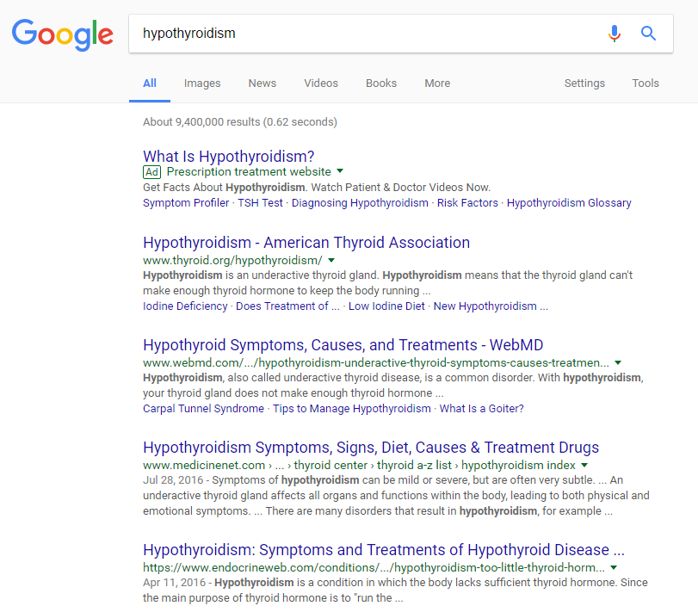
Information in a search engine is not organized and does not reveal ‘hidden’ content
Notes:
-information in libraries is organized in a variety of ways; WWW is not
-”hidden” or “dark” web vs open access: databases (esp. subscription) are not searched by search engine algorithms
-keyword vs. subject search

Slide 7
Library databases organize information into Access Points depending on the information provided
If source is known:
Title
Author(s)
If not:
Subject

Slide 8
Publication format is an access point
Books/eBooks
Journal/Magazine
Open Access/Subscription
Government Documents

Slide 9
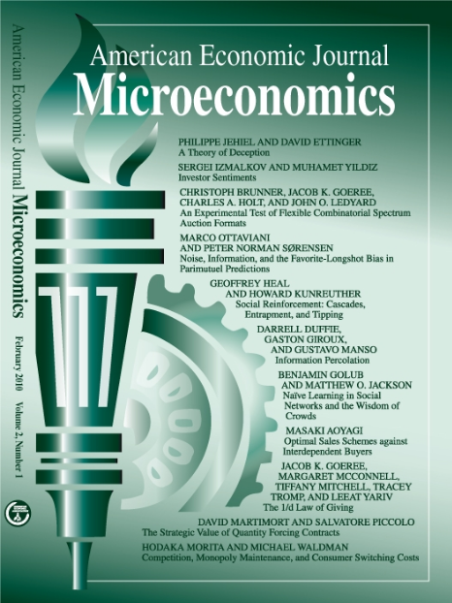
Popular publications focus on entertainment. Scholarly publications focus on informing.

Slide 10
Open Access sources are free to the public. Subscription sources are paid sources.

Slide 11
Is Wikipedia good or bad to use for research?

Slide 12
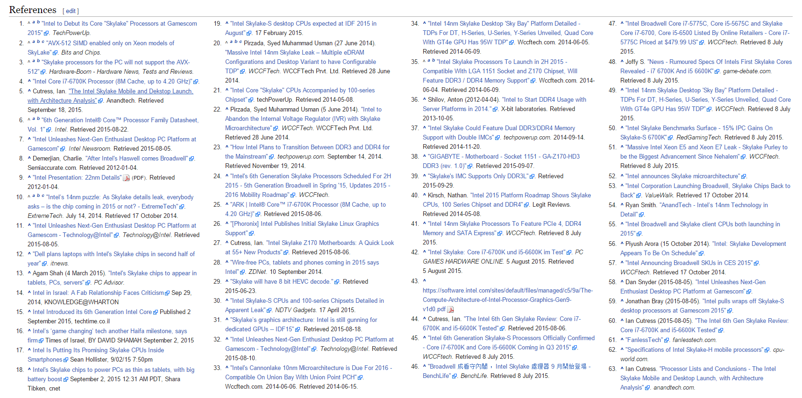
Good Wikipedia articles provide numerous references
Intel Skylake Microarchitecture

Slide 13
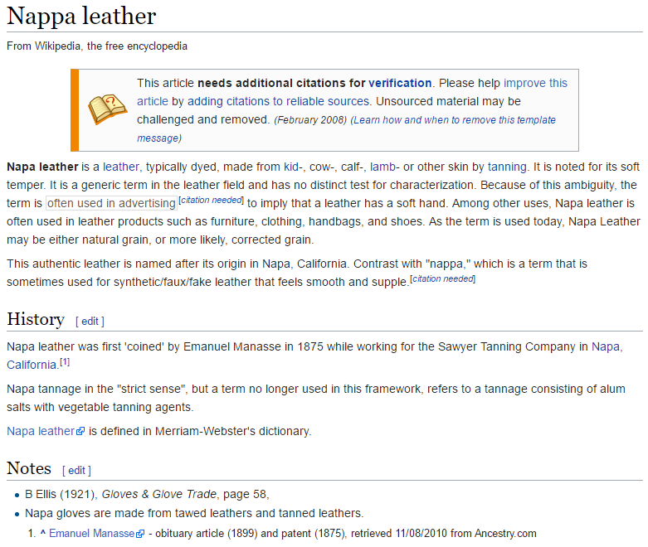
Bad Wikipedia articles contain misinformation and few sources

Slide 14
“Subject” is most commonly used access point in academic research and is the basis for classification systems
Dewey Decimal System
Library of Congress Classification System
Superintendent of Documents (SuDocs)
Notes:
Subject not necessarily the same as keyword

Slide 15
Dewey Decimal System is numeric and allows for broad classifications

Slide 16
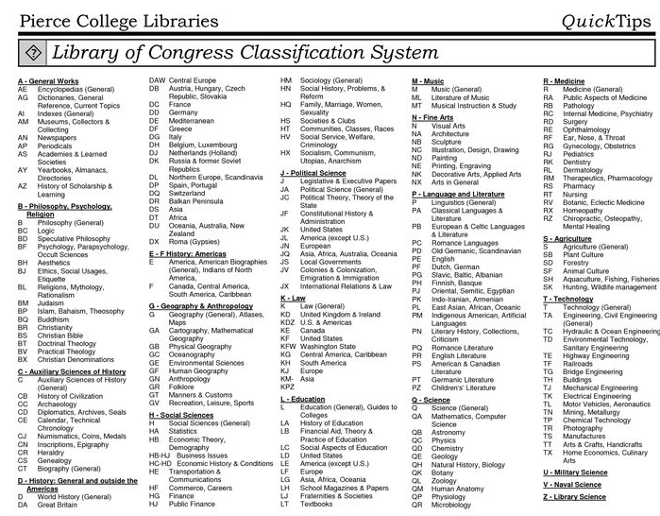
LCC is alpha-numeric and allows for more specific classifications

Slide 17
The ‘Active Shooter’ incident highlighted a number of issues the campus needs to resolve
There are no designated ‘safe spaces’ within the library
Doors that don’t lock, windows that cannot be blocked/covered
Confusing communication (Siren for ‘all clear’ and text messages not being sent)
The Library Director and the campus community are taking the highlighted shortcomings seriously and working with UPD to address them

Slide 18
Intellectual Property Issues

Slide 19
Intellectual Property is anything created by the mind
Intellectual Property laws – encourage innovation and creativity for the public good
Patent – gives exclusive right to inventors to develop and sell inventions for a period of time
Trademark – distinguishes businesses and products (logos, slogans, names)
Industrial design rights – protects the appearance of the product

Slide 20
Copyright
The original creator’s right to control their intellectual property
Ideas are not copyrighted, only the manifestations (books, papers, websites, photographs, etc)
Automatic from creation
Registration is available with US Copyright office
Required to file a lawsuit

Slide 21
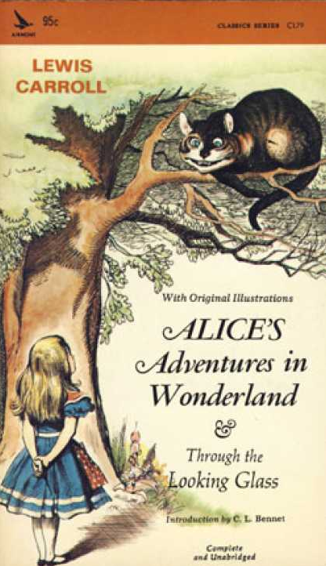
Public domain resources can be accessed and used by anyone
If you are unsure if something is in the Public Domain, cite it!

Slide 22
Fair Use
Allows limited use of copyrighted material for personal or academic use
Photocopying an encyclopedia entry for yourself
A teacher providing printouts of an article for students
Downloading a chart to your computer for yourself
If you are not sure, check!

Slide 23
Plagiarism
Using someone else’s work without giving credit
Ideas, direct quotations (aka language)
Academic work is to be original work – no sharing
Anything other than original work needs to be cited properly
Paraphrasing – rephrasing words without changing meaning
Direct quotation – using exact words
Summarizing – similar to paraphrasing, but condensed
Easily avoided by citing your sources!

Slide 24
Citations tell the reader what sources have been consulted and provide source information for researchers.
Style manuals (MLA, APA, Chicago) ensure consistency
Universal components:
Author
Title
Publishing information

Slide 25
MLA formatting requires parenthetical citations and a Works Cited page.
Author name within text
Wordsworth stated that Romantic poetry was marked by a "spontaneous overflow of powerful feelings" (263).
Page number
Romantic poetry is characterized by the "spontaneous overflow of powerful feelings" (Wordsworth 263).
Author name and page number

Slide 26
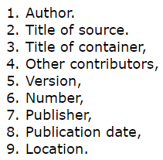
MLA 8th Ed. focuses on principle over prescription.
Name of the source’s source (name of a journal)
Name of the source
Digital object identifier.
Example: 10.1080/10502556.2014.972204
Name of the source’s source’s source (name of a database)
No longer requires format

Slide 27
Remember!
ALL
sources must be cited in your works cited page whether you directly referred to them in the work or not

Slide 28
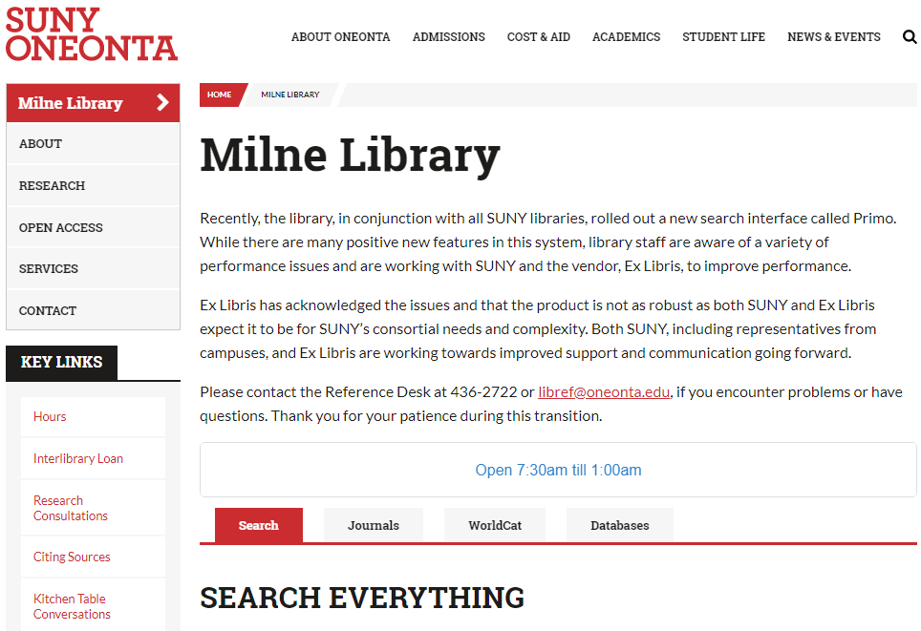
Style guides can be found in the library as well as online.

Slide 29
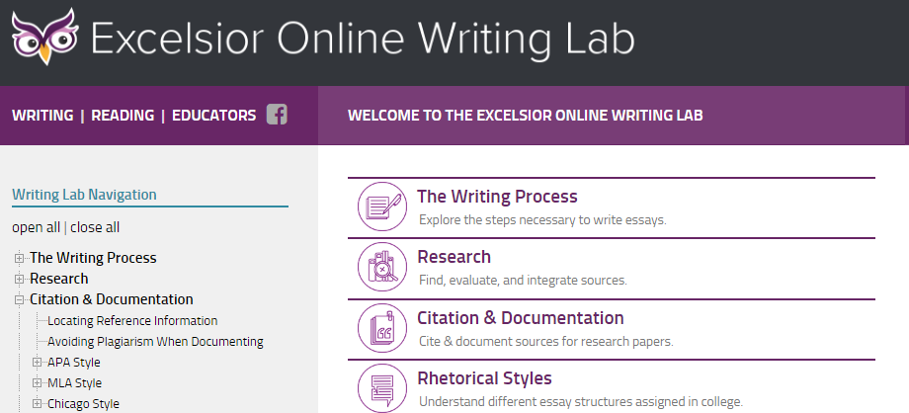
Excelsior OWL can help you find citation instructions
Excelsior OWL
https://owl.excelsior.edu/

Slide 30
A Note on Citation Generators
Easy but not 100% accurate
Do not use them for this class
OR
If you do, check that they are correct

Slide 31
Books use a publication page

Slide 32
Websites have an “about” or “contact” page
Check author name
Scroll to bottom of page

Slide 33
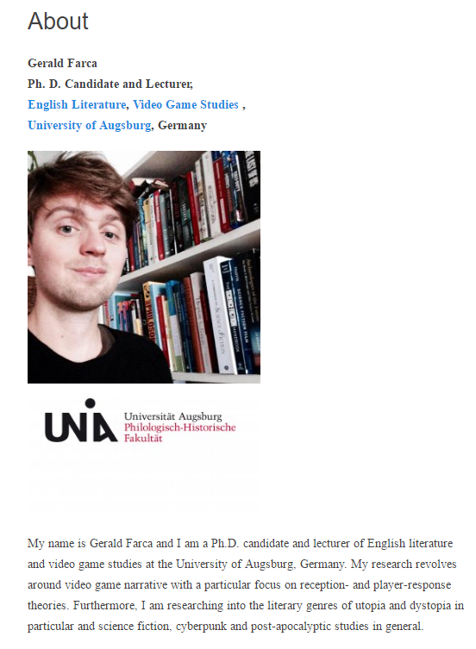
Blogs often contain “about” pages

Slide 34
Journals depend on format

